Slide 1


Capstone Project Phase A
Project code: 23-1-D-6
Using speech recognition
to execute full website functionality
Project Supervisor: Mr. Alexander Keselman
Students: Michael Ravich, Tal Derai

Slide 2
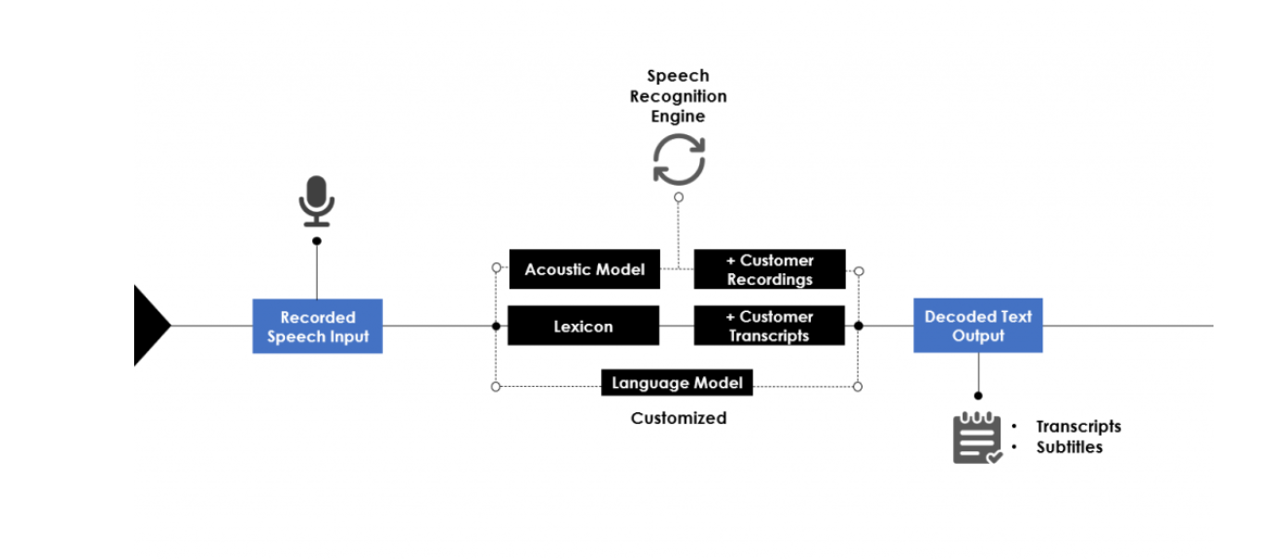
Background
Speech to text (STT) is the ability of machine to identify words and phrases in spoken language and convert them into text.

Slide 3
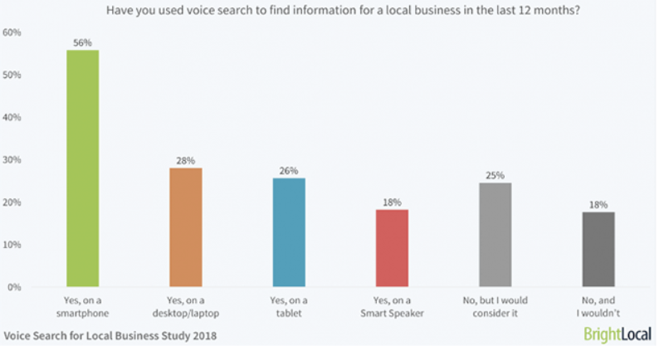
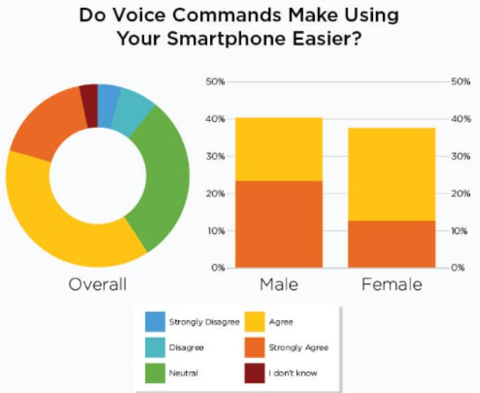
Motivation
AI technology is rapidly advancing
Voice search is preferred over typing
Helpful for people with disabilities, such as blind peoples
The market is huge – more and more people asking for it

Slide 4
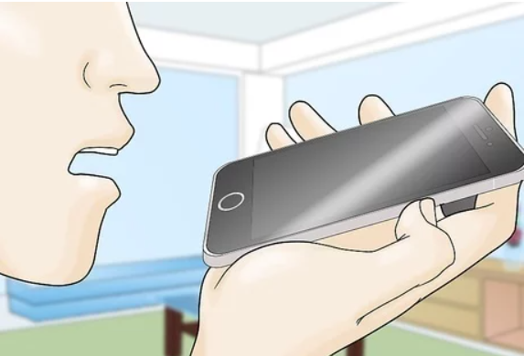


The problem
The main problem is mismatch between speech and the generated text
“Show me all action movies in Haifa”
“Shoe ne tall novies in taifa”

Slide 5
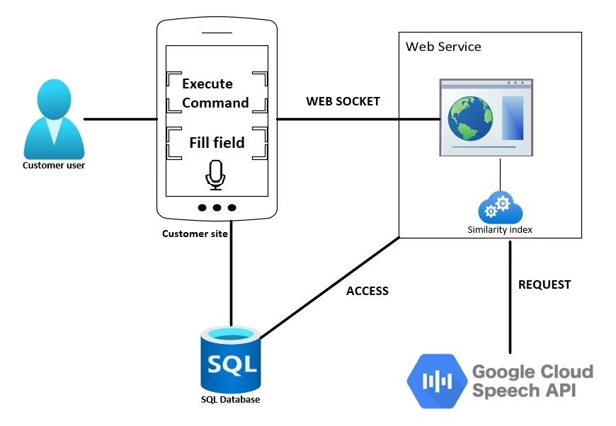
Our Solution

Slide 6
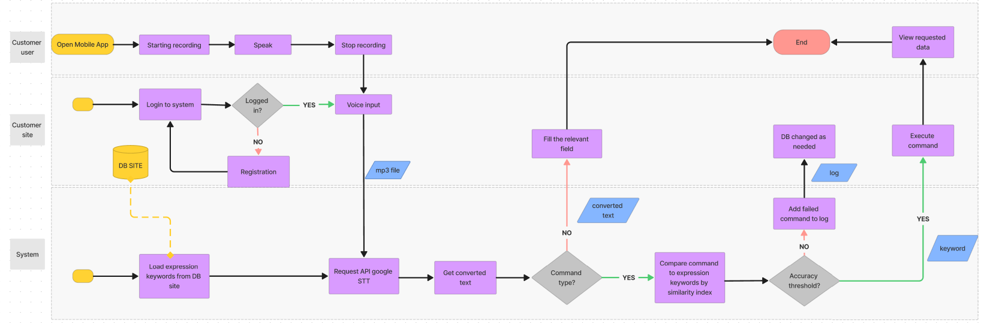
Activity Diagram

Slide 7
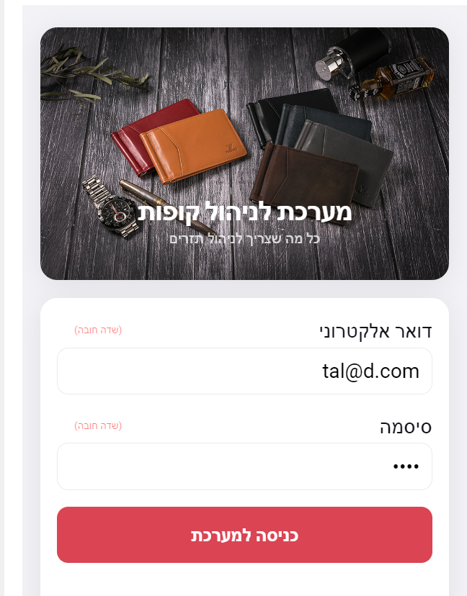
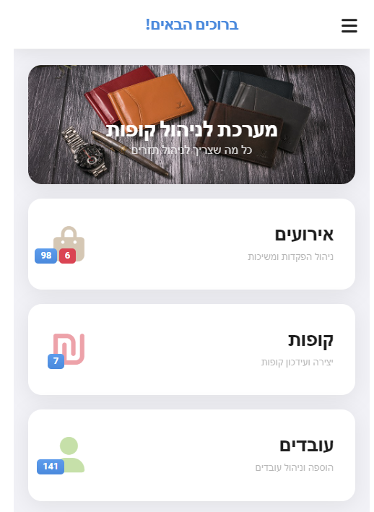

GUI
User Login Page
Main Page

Slide 8
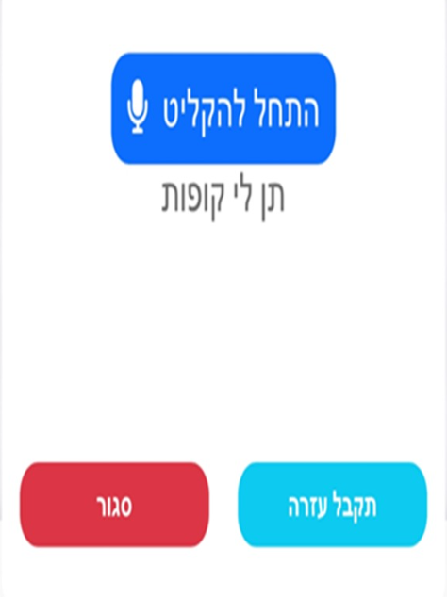
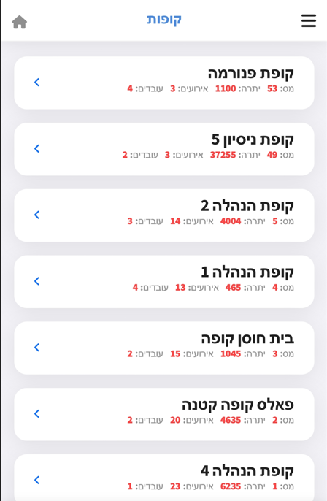
GUI
Recording Page
Results

Slide 9
Verification Plan
Expected Result | Testing Plan | Tested Module | Tested Function | Test
Customer site is filling the field with the extracted text that passed by system | Customer user tries to fill field by speech input | Customer Site, System | Filling Fields | 1.
Filling in log file with the content of the generated command | Customer user fails to execute some website functionality via speech command | System | User command failed | 2.
Customer site executes the requested functionality and shows the data | Customer user succeeds to execute some website functionality via speech command | Customer Site, System | User command passed | 3.
Returns the matching action for each command | System checks all possible commands in DB | System | Checking all speech command | 4.

Slide 10
Thanks for listening,
Any questions ?

